Slide 1
영국의 의료개혁
류재인
건강사회를 위한 치과의사회
구강보건정책연구회

Slide 2
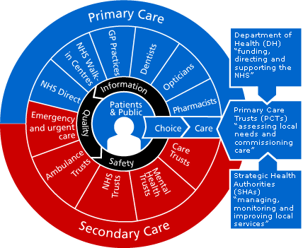
NHS diagram

Slide 3
Review
Health reform in England: update and commissioning framework
The NHS in England: the operating framework for 2007/08
Our health, our care, our say: a new direction for community services

Slide 4
Health reform in England
:update and commissiong framework

Slide 5
Contents
The reform programme
The right reforms for the right services
Choice and commissioning
Provider reform
System management and regulation
Incentives, the tariff and information

Slide 6
1. The reform programme
Introduction
Why reform?
Health reform driven locally
Benefits

Slide 7
Why reform?
The challenge of the future
  Rising expectation
  The demographic challenge
  The revolution in medical technology
  Continuing variations in the safety and quality of care

Slide 8
Why reform?
Clear vision of goal
  To develop a patient-led NHS that uses available resources as effectively and fairly as possible to promote health
  To reduce health inequalities
  To deliver the best and safest possible healthcare

Slide 9
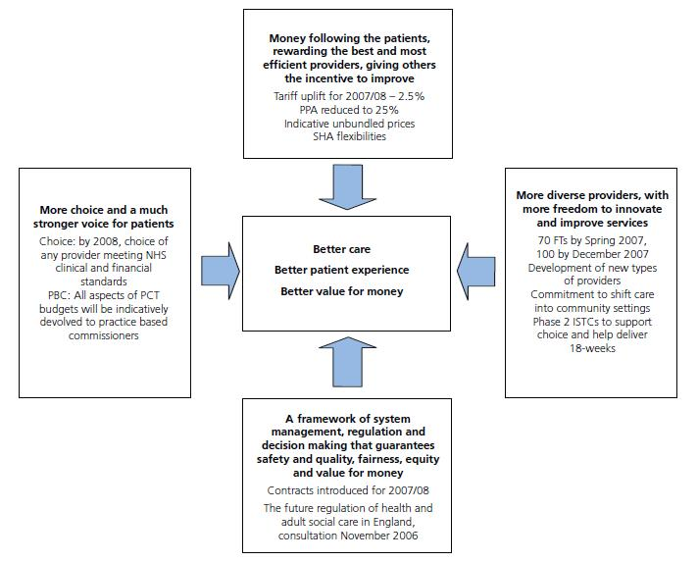
Health reform driven locally

Slide 10
The benefits
For the public and for patients
  Much better information
  More choice
  A more personalised service
  Faster, more convenient and more local care
  Integrated and ‘joined up’ care
  More sensitive provision
  Local consultation and NHS foundation membership
  Guaranteed core standards of safety and quality

Slide 11
The benefits
For staff
  More freedom from Whitehall
  New roles and responsibilities
  Quality of patient care
  Work collaboratively
  Clinical leadership and engagement
For taxpayers
  Modern NHS
  more productive and efficient NHS
  Strong and effective NHS

Slide 12
2. The right reforms for the right services
Patient-driven
  Choice, voice and competition
Commissioner-driven
  Contracting, contestability and service redesign
Nationally-driven
  Standards, targets, agencies and regulatory approaches

Slide 13
The NHS in England
: the operating framework for 2007/08

Slide 14
Contents
Patient choice and voice
  Patient choice
  Patient and public engagement
  Service reviews
  Care closer to home
Commissioning
  Practice based commissiong
  National NHS contracts
  Commissioning primary medical services
  Commissioning arrangements for specialised services
  Commissioining services for military personnel

Slide 15
Contents
Strengthening PCTs
  Strengthening providers
  Plurality of provision
Payment by results
  Scope
  Assurance
  SHA flexibilities
Information management and technology

Slide 16
Patient choice and voice
Patient choice
  All patients needing planned elective care will be able to choose to be treated by any provider that meets NHS clinical and financial standards
Patient and public engagement
Service reviews
  PCTs should undertake regular systematic reviews of the services they commission (including those they directly provide)
Care closer to home
  The shift of care into community settings and the other priorities set out

Slide 17
Commissioning
Joint commissioning between healthcare and social care and better integration between healthcare, social care and other local government services will bring benefits for patients and service users

Slide 18
Commissioning
Practice based commissioning
  GPs and primary care clinicians at the heart of decision-making, giving them the tools to innovate and influence local service development for the benefit of patients
National NHS contracts
  Patient booking and choice
  National and locally–agreed quality standards
  The activity plan and plan to deliver the 18 week target and manage demand
  Information requirements

Slide 19
Commissioning
Commissioning primary medical services
  The shift of services from secondary care to primary care, including planned investment to improve the premises from which primary medical services are provided
Commissioning arrangements for specialised services
Commissioining services for military personnel

Slide 20
Strengthening PCTs
The first stage
  strengthening the commissioning function of PCTs
The next stage
  Ensuring that PCTs are fit for purpose and have the opportunity to develop the right capabilities to carry out their roles in a system of choice, PBC, and commissioning in partnership from a plurality of providers

Slide 21
Strengthening providers
Strengthening NHS providers
  FT programme through the Whole Health Community Diagnostic giving more providers devolved decision-making responsibilities and enabling them to become more responsive to the needs of the local population
Plurality of provision
  To extend patient choice, increase quality and foster innovation

Slide 22
Our health, our care, our say
:a new direction for community services

Slide 23
Contents
Reforming health and social care
The context of the white paper
What the White paper will achieve
The White paper is aiming to achieve four main goals
How are we going to achieve these improvements
Conclusions

Slide 24
Reforming health and social care
The reform principles
  Patient choice
  Resources following those choices
  greater autonomy where it matters for local professionals

Slide 25
The White paper is aiming to achieve four main goals
Better prevention services with earlier intervention
More choice and a louder voice
More on tackling inequalities and improving access to community services
More support for people with long-term needs

Slide 26
How are we going to achieve these improvements?
Practice based commissioning
Shifting resources into prevention
More care undertaken outside hospitals and in the home
Better joining up of services at the local level
Encouraging innovation
Allowing different providers to compete for services

Slide 27
Conclusions
Our strategy
  To put people more in control
  To make services more responsive
  To focus on those with complex needs
  To shift care closer to home

Slide 28
감사합니다
류재인
jaeinryu@kihasa.re.kr

