Slide 1
Followings are evidences for fabrication from single corresponding authors. However, final judgment is on your sides. You may also can see fabrications from other journals and this will show you severe problems of this author.
If you want to require official information, please contact below:
Committee of Research Integrity at Seoul National University
jslee123@snu.ac.kr
Committee of Research Ethics at National Research Foundation of Korea
ctjin@nrf.re.kr
Committee of Research Ethics at Korea Health Industry Development Institute
clean@khidi.or.kr

Slide 2
Fabrications by Single Corresponding Author
Key points
1. Many different journals are involved
2. First author is not common
3. Intentionally modified blots
4. There were graphs based on fabricated blots
5. Difficult to find fabricated data as time goes by
Speculations
1. Corresponding author is involved
2. Possible to create graphs or images
3. Author will use unpublished raw data if it is available
4. If we don’t stop this author now, no one can prove fabrication later on
Question
Can you trust any kind of data from this corresponding author?

Slide 3
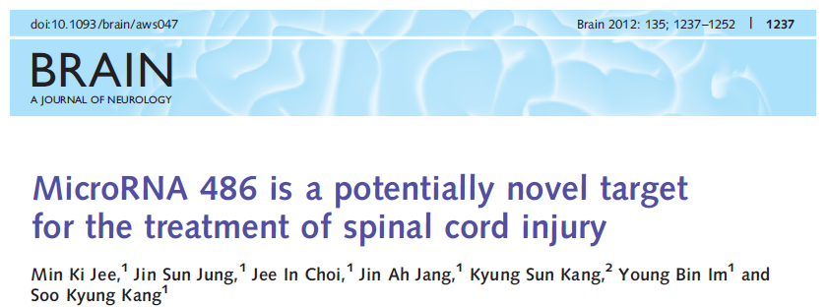

Slide 4
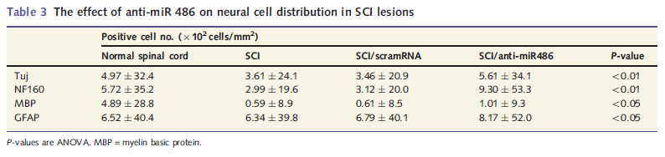
Brain 2012: 135; 1237–1252
MicroRNA 486 is a potentially novel target for the treatment of spinal cord injury
Error was much more greater than mean value. Is it significant?

Slide 5
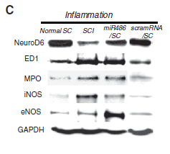
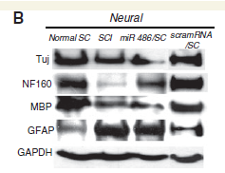
Brain 2012: 135; 1237–1252
MicroRNA 486 is a potentially novel target for the treatment of spinal cord injury
Figure 4C
Figure 4B
Same blot with different experimental set.

Slide 6
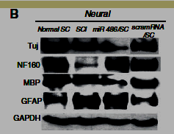
Brain 2012: 135; 1237–1252
MicroRNA 486 is a potentially novel target for the treatment of spinal cord injury
Figure 4B
Figure 4B
Last lane was artificially attached.

Slide 7
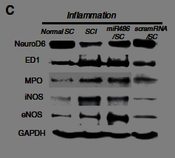
Brain 2012: 135; 1237–1252
MicroRNA 486 is a potentially novel target for the treatment of spinal cord injury
Figure 4C
Figure 4C
Last lane was artificially attached.

Slide 8
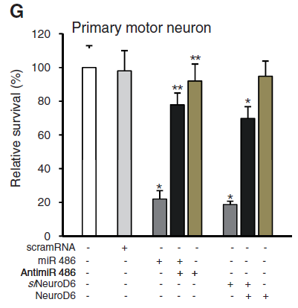
Brain 2012: 135; 1237–1252
MicroRNA 486 is a potentially novel target for the treatment of spinal cord injury
Artificial error bar
Figure 4G

Slide 9
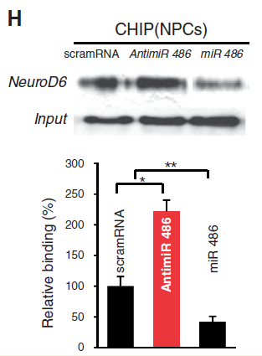
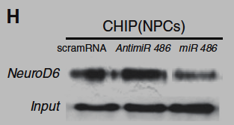
Brain 2012: 135; 1237–1252
MicroRNA 486 is a potentially novel target for the treatment of spinal cord injury
Last lane was artificially attached.
How quantified?
Figure 4H

Slide 10
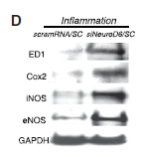
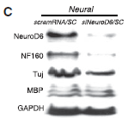
Brain 2012: 135; 1237–1252
MicroRNA 486 is a potentially novel target for the treatment of spinal cord injury
Figure 5C
Figure 5D
Same blot with different experimental set.

Slide 11
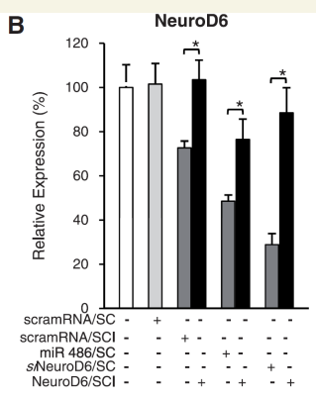
Brain 2012: 135; 1237–1252
MicroRNA 486 is a potentially novel target for the treatment of spinal cord injury
Error bar was artificially attached
Figure 6B

Slide 12
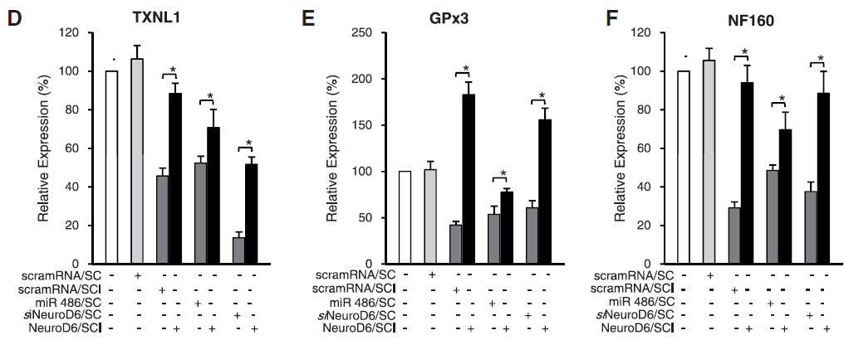
Brain 2012: 135; 1237–1252
MicroRNA 486 is a potentially novel target for the treatment of spinal cord injury
Figure 6D-6F
Error bar was artificially attached

Slide 13
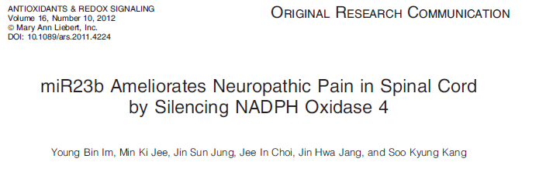

Slide 14
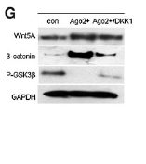
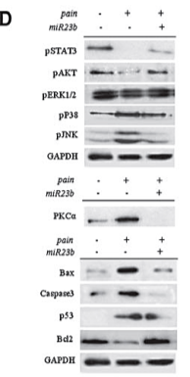
ANTIOXIDANTS & REDOX SIGNALING Volume 16, Number 10, 2012 10.1089/ars.2011.4224
miR23b Ameliorates Neuropathic Pain in Spinal Cord by Silencing NADPH Oxidase 4
Same blot was used
Figure 3G
ANTIOXIDANTS & REDOX SIGNALING Volume 16, Number 2, 2012
Crucial Role of Nuclear Ago2 for hUCB-MSCs Differentiation and Self-Renewal via Stemness Control
Figure 1D

Slide 15
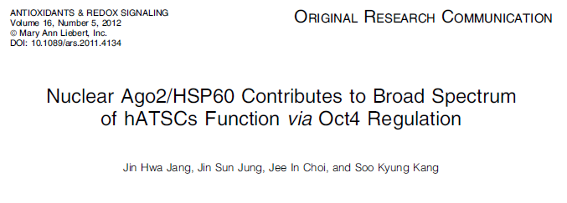

Slide 16
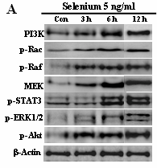
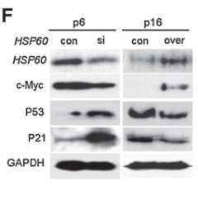

ANTIOXIDANTS & REDOX SIGNALING Volume 16, Number 5, 2012 DOI: 10.1089/ars.2011.4134
Nuclear Ago2/HSP60 Contributes to Broad Spectrum of hATSCs Function via Oct4 Regulation
Same blot was used
Figure 3F
Figure 2A
STEM CELLS 2008;26:2724–2734
IFATS Series: Selenium Induces Improvement of Stem Cell Behaviors in Human Adipose-Tissue Stromal Cells via SAPK/JNK and Stemness Acting Signals

Slide 17
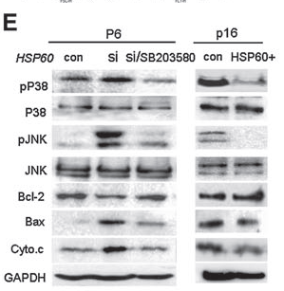
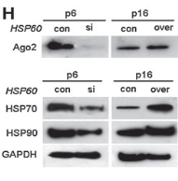
ANTIOXIDANTS & REDOX SIGNALING Volume 16, Number 5, 2012 DOI: 10.1089/ars.2011.4134
Nuclear Ago2/HSP60 Contributes to Broad Spectrum of hATSCs Function via Oct4 Regulation
Same blot was used for different
experimental set
Figure 4E
Figure 3H

Slide 18


ANTIOXIDANTS & REDOX SIGNALING Volume 16, Number 2, 2012
Crucial Role of Nuclear Ago2 for hUCB-MSCs Differentiation and Self-Renewal via Stemness Control
Figure 1B
Two lanes are artificially joined

Slide 19
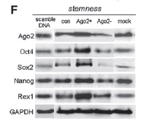
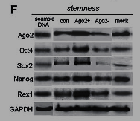
ANTIOXIDANTS & REDOX SIGNALING Volume 16, Number 2, 2012
Crucial Role of Nuclear Ago2 for hUCB-MSCs Differentiation and Self-Renewal via Stemness Control
Figure 2F
Two lanes are artificially joined

Slide 20
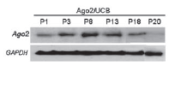
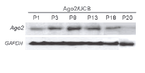
ANTIOXIDANTS & REDOX SIGNALING Volume 16, Number 2, 2012
Crucial Role of Nuclear Ago2 for hUCB-MSCs Differentiation and Self-Renewal via Stemness Control
Two lanes are artificially joined
Figure 2H

Slide 21


ANTIOXIDANTS & REDOX SIGNALING Volume 16, Number 2, 2012
Crucial Role of Nuclear Ago2 for hUCB-MSCs Differentiation and Self-Renewal via Stemness Control
Lanes are artificially joined
Figure 2J

Slide 22
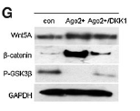
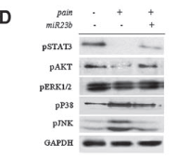
ANTIOXIDANTS & REDOX SIGNALING Volume 16, Number 2, 2012
Crucial Role of Nuclear Ago2 for hUCB-MSCs Differentiation and Self-Renewal via Stemness Control
Same blot was used
Figure 3G
Figure 1D
ANTIOXIDANTS & REDOX SIGNALING Volume 16, Number 10, 2012 10.1089/ars.2011.4224
miR23b Ameliorates Neuropathic Pain in Spinal Cord by Silencing NADPH Oxidase 4

Slide 23
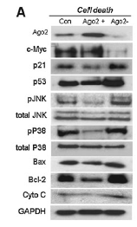
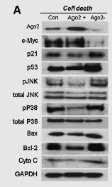
ANTIOXIDANTS & REDOX SIGNALING Volume 16, Number 2, 2012
Crucial Role of Nuclear Ago2 for hUCB-MSCs Differentiation and Self-Renewal via Stemness Control
Three conditions
Total number of lane is two.
Figure 4A

Slide 24
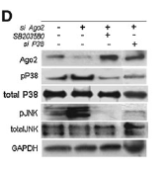
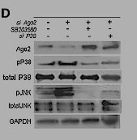
ANTIOXIDANTS & REDOX SIGNALING Volume 16, Number 2, 2012
Crucial Role of Nuclear Ago2 for hUCB-MSCs Differentiation and Self-Renewal via Stemness Control
Figure 4D
Last lane was artificially joined

Slide 25
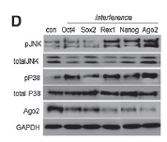
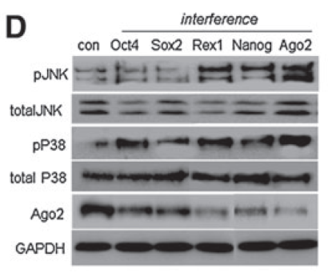
ANTIOXIDANTS & REDOX SIGNALING Volume 16, Number 2, 2012
Crucial Role of Nuclear Ago2 for hUCB-MSCs Differentiation and Self-Renewal via Stemness Control
Artificially joined lanes
Figure 5D

Slide 26
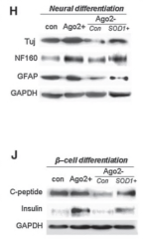
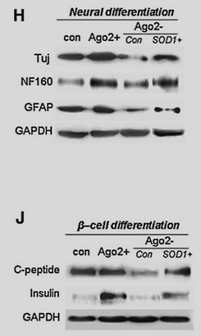
ANTIOXIDANTS & REDOX SIGNALING Volume 16, Number 2, 2012
Crucial Role of Nuclear Ago2 for hUCB-MSCs Differentiation and Self-Renewal via Stemness Control
Figure 6H and 6J
Last lane was artificially joined

Slide 27
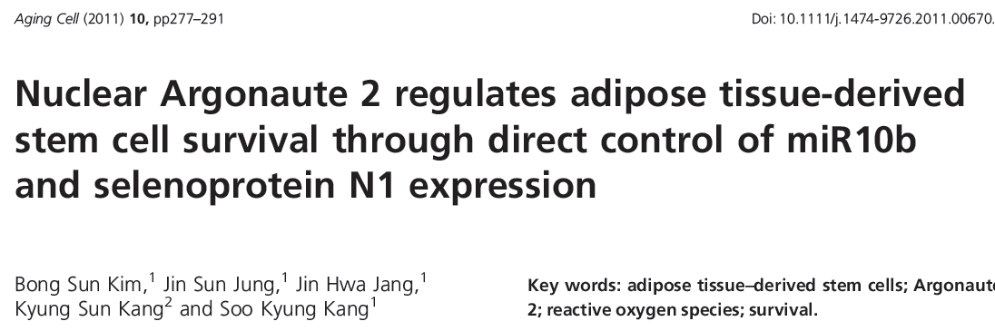

Slide 28
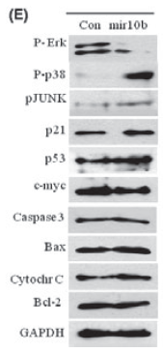
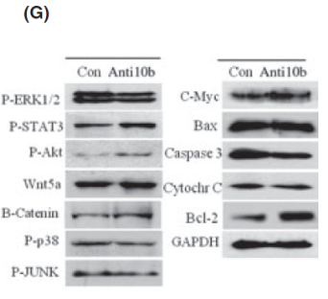
Aging Cell (2011) 10, pp277–291
Nuclear Argonaute 2 regulates adipose tissue-derived stem cell survival through direct control of miR10b and selenoprotein N1 expression
Different set of experiments
Same blot was used
Figure 4G
Figure 3E

Slide 29


Slide 30
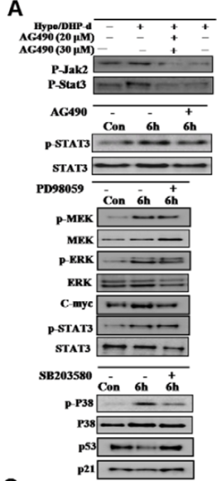



PLoS ONE | www.plosone.org 1 February 2010 | Volume 5 | Issue 2 | e9026
DHP-Derivative and Low Oxygen Tension Effectively Induces Human Adipose Stromal Cell Reprogramming
Figure 5(B)
Cell Prolif. 2008, 41, 248–264
Transforming growth factor-β1 regulates the fate of cultured spinal cord-derived neural progenitor cells
Same blot was used
Figure 3A

Slide 31
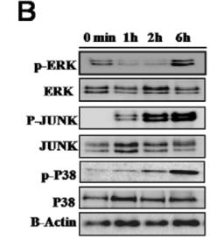
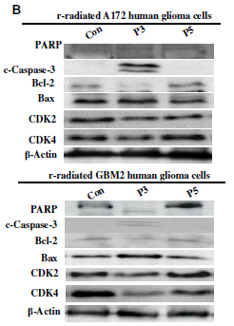
PLoS ONE | www.plosone.org 1 February 2010 | Volume 5 | Issue 2 | e9026
DHP-Derivative and Low Oxygen Tension Effectively Induces Human Adipose Stromal Cell Reprogramming
Same blot was used
Figure 4B
Figure 3B
BMC Neuroscience 2008, 9:15
Potential identity of multi-potential cancer stem-like subpopulation
after radiation of cultured brain glioma

Slide 32
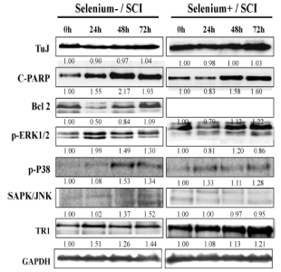

PLoS ONE | www.plosone.org 1 February 2010 | Volume 5 | Issue 2 | e9026
DHP-Derivative and Low Oxygen Tension Effectively Induces Human Adipose Stromal Cell Reprogramming
Same blot was used
Figure 4B
Figure 7
Cellular Physiology and Biochemistry 2008;21:225-238
Selenium Attenuates ROS-Mediated Apoptotic nCell Death of Injured Spinal Cord through Prevention of Mitochondria Dysfunction; in Vitro and in Vivo Study

Slide 33

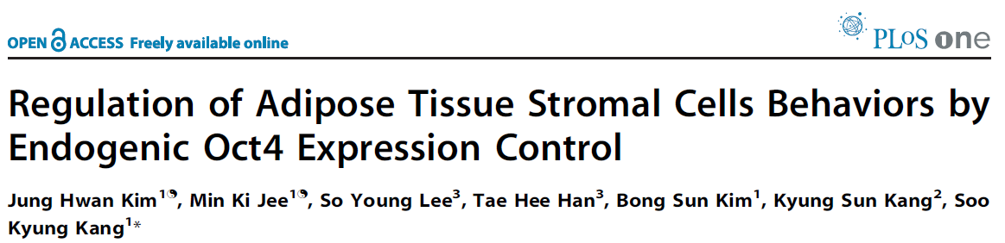

Slide 34
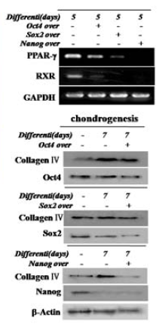
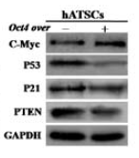

PLoS ONE | www.plosone.org 1 September 2009 | Volume 4 | Issue 9 | e7166
Regulation of Adipose Tissue Stromal Cells Behaviors by Endogenic Oct4 Expression Control
Same blot was used
Figure 1C
Figure 5B

Slide 35
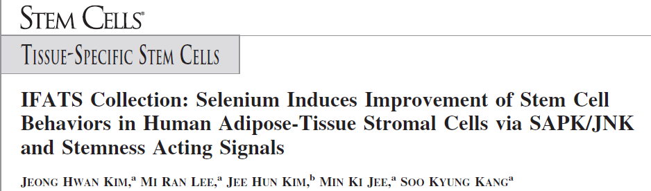

Slide 36
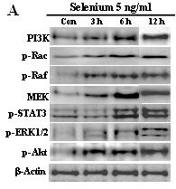
STEMCELLS 2008;26:2724–2734
IFATS Series: Selenium Induces Improvement of Stem Cell Behaviors in Human Adipose-Tissue Stromal Cells via SAPK/JNK and Stemness Acting Signals
Attach 12h lane from
other data
Figure 2A

Slide 37
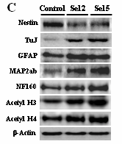

STEMCELLS 2008;26:2724–2734
IFATS Series: Selenium Induces Improvement of Stem Cell Behaviors in Human Adipose-Tissue Stromal Cells via SAPK/JNK and Stemness Acting Signals
Same blot was used
Figure 4C
Same Paper
Figure 2A

Slide 38
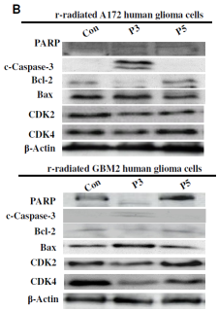
STEMCELLS 2008;26:2724–2734
IFATS Series: Selenium Induces Improvement of Stem Cell Behaviors in Human Adipose-Tissue Stromal Cells via SAPK/JNK and Stemness Acting Signals
Figure 2A
Same blot was used
Figure 3B
BMC Neuroscience 2008, 9:15
Potential identity of multi-potential cancer stem-like subpopulation after radiation of cultured brain glioma

Slide 39
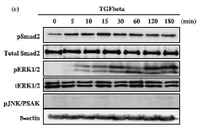
STEMCELLS 2008;26:2724–2734
IFATS Series: Selenium Induces Improvement of Stem Cell Behaviors in Human Adipose-Tissue Stromal Cells via SAPK/JNK and Stemness Acting Signals
Same blot was used
Figure 2A
Figure 1(C)
Cell Prolif. 2008, 41, 248–264
Transforming growth factor-β1 regulates the fate of cultured spinal cord-derived neural progenitor cells

Slide 40

STEMCELLS 2008;26:2724–2734
IFATS Series: Selenium Induces Improvement of Stem Cell Behaviors in Human Adipose-Tissue Stromal Cells via SAPK/JNK and Stemness Acting Signals
Same blot was used
Figure 2A
Figure 3A
Cell Physiol Biochem 2008;21:225-238
Selenium Attenuates ROS-Mediated Apoptotic Cell Death of Injured Spinal Cord through Prevention of Mitochondria Dysfunction; in Vitro and in Vivo Study

Slide 41
STEMCELLS 2008;26:2724–2734
IFATS Series: Selenium Induces Improvement of Stem Cell Behaviors in Human Adipose-Tissue Stromal Cells via SAPK/JNK and Stemness Acting Signals
Figure 2A
Figure 3F
ANTIOXIDANTS & REDOX SIGNALING Volume 16, Number 5, 2012 DOI: 10.1089/ars.2011.4134
Nuclear Ago2/HSP60 Contributes to Broad Spectrum of hATSCs Function via Oct4 Regulation

Slide 42


STEMCELLS 2008;26:2724–2734
IFATS Series: Selenium Induces Improvement of Stem Cell Behaviors in Human Adipose-Tissue Stromal Cells via SAPK/JNK and Stemness Acting Signals
Flip Horizontally
Figure 3A
Cell Physiol Biochem 2008;21:225-238
Selenium Attenuates ROS-Mediated Apoptotic Cell Death of Injured Spinal Cord through Prevention of Mitochondria Dysfunction; in Vitro and in Vivo Study
Rotate clockwise
Figure 2B
Same blot was used

Slide 43


Slide 44


Cell Prolif. 2008, 41, 377–392
Interleukin-6 induces proliferation in adult spinal cord-derived
neural progenitors via the JAK2/STAT3 pathway with EGF-induced MAPK phosphorylation
Same blot was used
Rotate 180º
Figure 7
Figure 1(C)
Cell Prolif. 2008, 41, 248–264
Transforming growth factor-β1 regulates the fate of cultured spinal cord-derived neural progenitor cells

Slide 45


Slide 46
Cell Prolif. 2008, 41, 248–264
Transforming growth factor-β1 regulates the fate of cultured spinal cord-derived neural progenitor cells
Total data points are 8
Total data points are 7
Figure 1C

Slide 47

Cell Prolif. 2008, 41, 248–264
Transforming growth factor-β1 regulates the fate of cultured spinal cord-derived neural progenitor cells
Figure 1C
Changed brightness
Same blot was used
Figure 5A

Slide 48


Cell Prolif. 2008, 41, 248–264
Transforming growth factor-β1 regulates the fate of cultured spinal cord-derived neural progenitor cells
Same blot was used
Figure 1C
Figure 4C
Cell Physiol Biochem 2008;21:225-238
Selenium Attenuates ROS-Mediated Apoptotic Cell Death of Injured Spinal Cord through Prevention of Mitochondria Dysfunction; in Vitro and in Vivo Study

Slide 49

Cell Prolif. 2008, 41, 248–264
Transforming growth factor-β1 regulates the fate of cultured spinal cord-derived neural progenitor cells
Figure 1C
Same blot was used
Figure 3A
Cell Physiol Biochem 2008;21:225-238
Selenium Attenuates ROS-Mediated Apoptotic Cell Death of Injured Spinal Cord through Prevention of Mitochondria Dysfunction; in Vitro and in Vivo Study

Slide 50
Cell Prolif. 2008, 41, 248–264
Transforming growth factor-β1 regulates the fate of cultured spinal cord-derived neural progenitor cells
Same blot was used
Figure 2A
STEMCELLS 2008;26:2724–2734
IFATS Series: Selenium Induces Improvement of Stem Cell Behaviors in Human Adipose-Tissue Stromal Cells via SAPK/JNK and Stemness Acting Signals
Figure 1C

Slide 51
Cell Prolif. 2008, 41, 248–264
Transforming growth factor-β1 regulates the fate of cultured spinal cord-derived neural progenitor cells
Figure 1C
Same blot was used
Figure 3A
Cell Physiol Biochem 2008;21:225-238
Selenium Attenuates ROS-Mediated Apoptotic Cell Death of Injured Spinal Cord through Prevention of Mitochondria Dysfunction; in Vitro and in Vivo Study

Slide 52


Cell Prolif. 2008, 41, 248–264
Transforming growth factor-β1 regulates the fate of cultured spinal cord-derived neural progenitor cells
Same blot with different exposure time
Figure 5(a)

Slide 53

Cell Prolif. 2008, 41, 248–264
Transforming growth factor-β1 regulates the fate of cultured spinal cord-derived neural progenitor cells
Same blot: modify contrast and different scanning position
Figure 5(a)

Slide 54
Cell Prolif. 2008, 41, 248–264
Transforming growth factor-β1 regulates the fate of cultured spinal cord-derived neural progenitor cells
Figure 5(B)
Same blot was used
PLoS ONE | www.plosone.org 1 February 2010 | Volume 5 | Issue 2 | e9026
DHP-Derivative and Low Oxygen Tension Effectively Induces Human Adipose Stromal Cell Reprogramming
Figure 3A

Slide 55

Cell Prolif. 2008, 41, 248–264
Transforming growth factor-β1 regulates the fate of cultured spinal cord-derived neural progenitor cells
Data point: 7
Data point: 6
Data point: 7
Data point: 6
Data point: 7
Figure 6(a)

Slide 56


Slide 57

BMC Neuroscience 2008, 9:15
Potential identity of multi-potential cancer stem-like subpopulation after radiation of cultured brain glioma
Redundant e-mail address and two different e-mail addresses belong to corresponding author: In this case, no one knows what happens except corresponding author

Slide 58



BMC Neuroscience 2008, 9:15
Potential identity of multi-potential cancer stem-like subpopulation after radiation of cultured brain glioma
Same blot was used
Figure 5B
Biochimica et Biophysica Acta 1772 (2007) 1199–1210
Selenium effectively inhibits ROS-mediated apoptotic neural precursor cell death in vitro and in vivo in traumatic brain injury
Figure 3B

Slide 59
BMC Neuroscience 2008, 9:15
Potential identity of multi-potential cancer stem-like subpopulation after radiation of cultured brain glioma
Same blot was used
Figure 4B
PLoS ONE | www.plosone.org 1 February 2010 | Volume 5 | Issue 2 | e9026
DHP-Derivative and Low Oxygen Tension Effectively Induces Human Adipose Stromal Cell Reprogramming
Figure 3B

Slide 60


Slide 61

Cell Physiol Biochem 2008;21:225-238
Selenium Attenuates ROS-Mediated Apoptotic Cell Death of Injured Spinal Cord through Prevention of Mitochondria Dysfunction;in Vitro and in Vivo Study
Different blots were recombined
Figure 3A

Slide 62

Cell Physiol Biochem 2008;21:225-238
Selenium Attenuates ROS-Mediated Apoptotic Cell Death of Injured Spinal Cord through Prevention of Mitochondria Dysfunction;in Vitro and in Vivo Study
Figure 3A
Same blot was used
Figure 2A
STEMCELLS 2008;26:2724–2734
IFATS Series: Selenium Induces Improvement of Stem Cell Behaviors in Human Adipose-Tissue Stromal Cells via SAPK/JNK and Stemness Acting Signals

Slide 63




Cell Physiol Biochem 2008;21:225-238
Selenium Attenuates ROS-Mediated Apoptotic Cell Death of Injured Spinal Cord through Prevention of Mitochondria Dysfunction;in Vitro and in Vivo Study
Same blot was used
Figure 4C
Figure 1C
Cell Prolif. 2008, 41, 248–264
Transforming growth factor-β1 regulates the fate of cultured spinal cord-derived neural progenitor cells

Slide 64

Cell Physiol Biochem 2008;21:225-238
Selenium Attenuates ROS-Mediated Apoptotic Cell Death of Injured Spinal Cord through Prevention of Mitochondria Dysfunction;in Vitro and in Vivo Study
Same blot was used
Figure 4C
Figure 5(a)
Cell Prolif. 2008, 41, 248–264
Transforming growth factor-β1 regulates the fate of cultured spinal cord-derived neural progenitor cells

Slide 65



Cell Physiol Biochem 2008;21:225-238
Selenium Attenuates ROS-Mediated Apoptotic Cell Death of Injured Spinal Cord through Prevention of Mitochondria Dysfunction;in Vitro and in Vivo Study
Same blot was used
Figure 7
Figure 3B
Biochimica et Biophysica Acta 1772 (2007) 1199–1210
Selenium effectively inhibits ROS-mediated apoptotic neural precursor cell death in vitro and in vivo in traumatic brain injury

Slide 66


Cell Physiol Biochem 2008;21:225-238
Selenium Attenuates ROS-Mediated Apoptotic Cell Death of Injured Spinal Cord through Prevention of Mitochondria Dysfunction;in Vitro and in Vivo Study
Same blot was used
Figure 7
Figure 3B
Biochemical and Biophysical Research Communications 348 (2006) 560–570
Molecular insights of the injured lesions of rat spinal cords:
Inflammation, apoptosis, and cell survival

Slide 67

Cell Physiol Biochem 2008;21:225-238
Selenium Attenuates ROS-Mediated Apoptotic Cell Death of Injured Spinal Cord through Prevention of Mitochondria Dysfunction;in Vitro and in Vivo Study
Same blot was used
Figure 5(b)
Cell Prolif. 2008, 41, 248–264
Transforming growth factor-β1 regulates the fate of cultured spinal cord-derived neural progenitor cells
Figure 7

Slide 68

Cell Physiol Biochem 2008;21:225-238
Selenium Attenuates ROS-Mediated Apoptotic Cell Death of Injured Spinal Cord through Prevention of Mitochondria Dysfunction;in Vitro and in Vivo Study
Same blot was used
Figure 7
Figure 4B
PLoS ONE | www.plosone.org 1 February 2010 | Volume 5 | Issue 2 | e9026
DHP-Derivative and Low Oxygen Tension Effectively Induces Human Adipose Stromal Cell Reprogramming

Slide 69


Slide 70

Biochemical and Biophysical Research Communications 348 (2006) 560–570
Molecular insights of the injured lesions of rat spinal cords: Inflammation, apoptosis, and cell survival
Figure 3B
Same blot was used
Figure 7
Cell Physiol Biochem 2008;21:225-238
Selenium Attenuates ROS-Mediated Apoptotic Cell Death of Injured Spinal Cord through Prevention of Mitochondria Dysfunction; in Vitro and in Vivo Study

